Slide 1
Temperature & Humidity Sensing
Jason Pearson • Justin Koehler • Marcel Englmaier

Slide 2
Introduction
Background
Design Decisions
Design
Implementation
Testing
Security
Enrichments
Maintenance
Summary

Slide 3
Background

Slide 4

Background - Client
Western Michigan University
Dr. John Kapenga

Slide 5
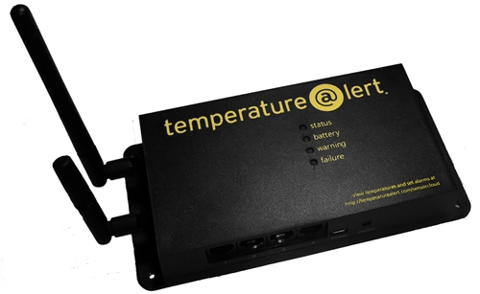
Background
Current Setup:
1 Temperature@lert sensor in each server room.
Too few sensors relative to the high cost of equipment
No central management server

Slide 6
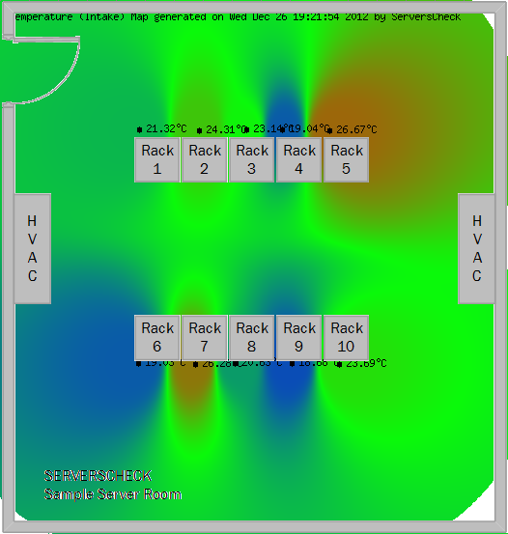
Background – Why More
Notes:
Don’t forget to doctor this picture
Animate dead zones
Talk about if HVAC dies

Slide 7
Background – Previous Team
Developed site that communicates with current sensors.
Features include room/group management and user authentication with permission levels
Implementation in Laravel 3
Sensors report only real-time temperature

Slide 8
Background – Unmet Needs
Additional metrics desired such as humidity
Ability to connect to sensors other than Temperature@lert
In-house built sensors that are
Extensible
Low-cost
Modifiable
Open source
Notes:
Stress project goals

Slide 9
Design Decisions

Slide 10



Design Decisions - Environment
Raspberry Pi
Low-cost
Readily available
Widely documented
Extensible
Laravel
Open source
Most popular PHP framework
Secure
Reliable MVC
Externally Hosted
Safe off-site location
Easy maintenance
Notes:
Pi – cheap, overnightable from

Slide 11


Design Decisions - Improvement
Boot Strap
Open source
Well Documented
Tablet and Phone Support
Google Charts
Open source
Mobile support
Notes:
Pi – cheap, overnightable from

Slide 12


Design Decisions - Language
Sensor driver
Python for speed, doesn’t need compilation
Web Site
LAMP Stack
Laravel Framework
Notes:
LAMP – elaborate to it standing for linux, apache2, mysql, php – all open source, free, secure, fast, reliable
Laravel – secure,

Slide 13
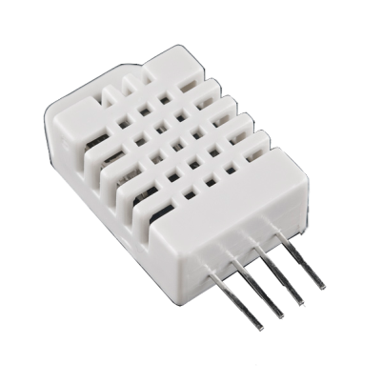
Design Decisions - Hardware
DHT22 Sensor
Temperature Accuracy ±0.5º C
Temperature Range -40 to 80°C
Humidity Accuracy ±0.1Φ
Humidity Range 0-100%
Raspberry Pi
Expandable to 17 concurrent sensors
Runs a full web server
Wireless N adapter
Long range
Low price
Notes:
Φ is relative humidity
Web server - debugging

Slide 14
Design

Slide 15
Design
Laravel
Pi Hosted XML
Pi
Linux
Sensor
Apache
MySQL
PHP

Slide 16
Design – Pi and Sensor Communication
Uses Python to communicate to the device
Python sends a request
Sensor responds
Output written to XML file
XML
Pi
Sensor

Slide 17
Design – Pi and Server Communication
Apache hosts XML file for server to retrieve
Server has different drivers for different devices
Parses XML according to driver
Temperature information handled by server
Laravel
Pi Hosted XML
Pi
Linux
Apache
MySQL
PHP
Notes:
Admin choose refresh interval – 1 minute, 2 minute, 5, 10 etc
Apache hosts, server fetches, server stores in mysql, server queries database for specified drivers with time range, laravel preprocesses php, bootstrap renders based on device

Slide 18
Implementation

Slide 19
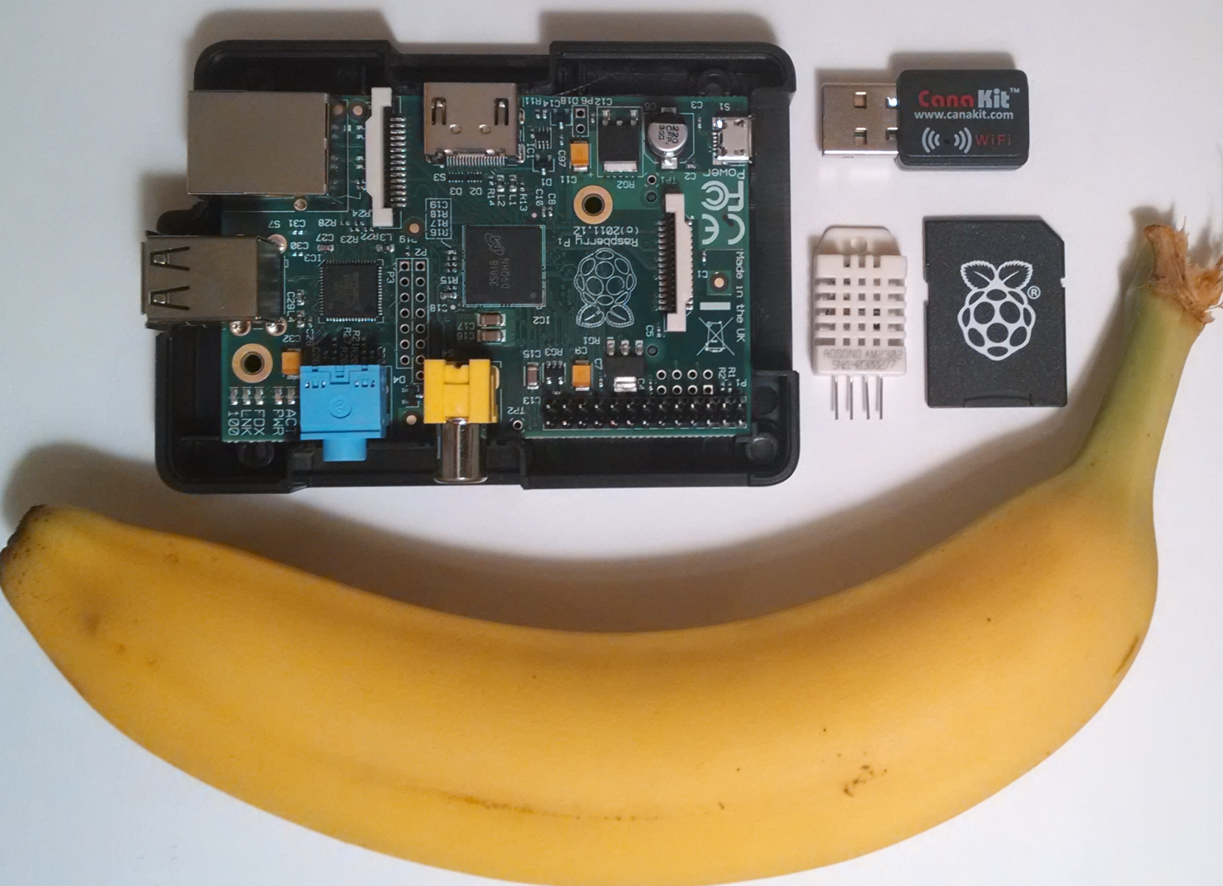
Implementation
Banana for scale.

Slide 20
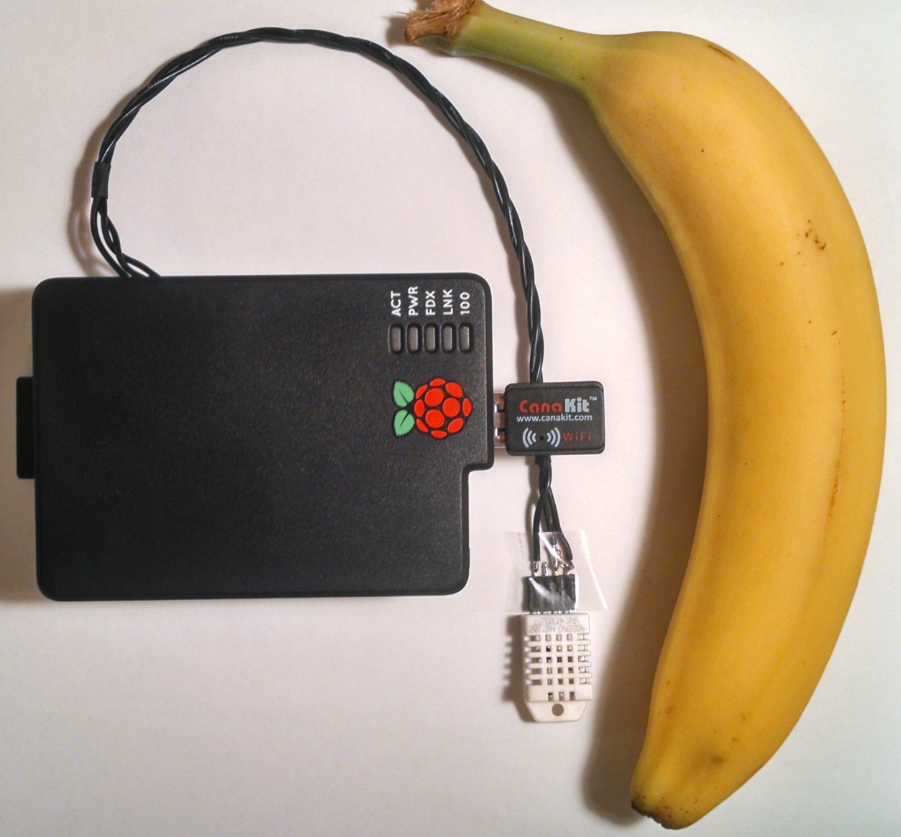
Implementation

Slide 21
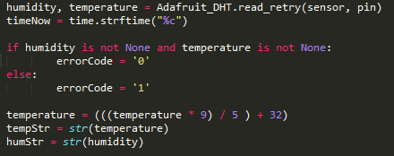
Implementation

Slide 22
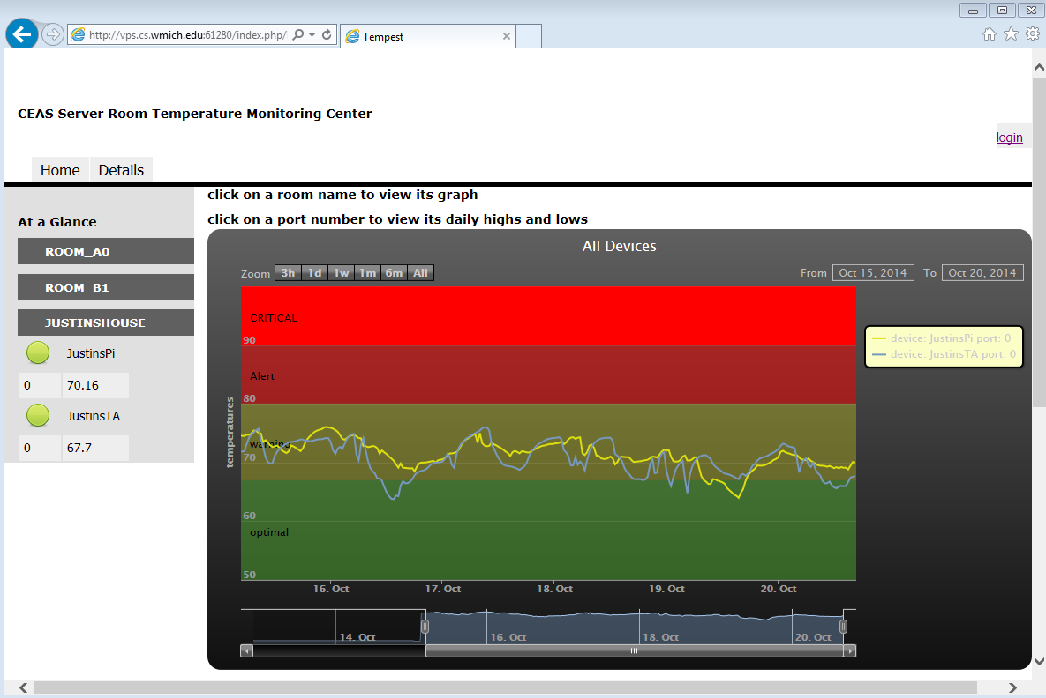
Implementation Before Bootstrap on Desktop
Picture of site on desktop old site and new with bootstrap

Slide 23
Implementation After Bootstrap on Desktop
Picture of site on desktop with bootstrap scaffolding and navtabs

Slide 24
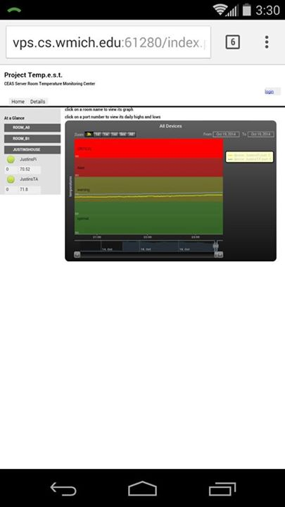
Implementation Before Bootstrap on Mobile

Slide 25
Implementation After Bootstrap on Mobile
Picture of site on a mobile device with bootstrap scaffolding and navtabs

Slide 26
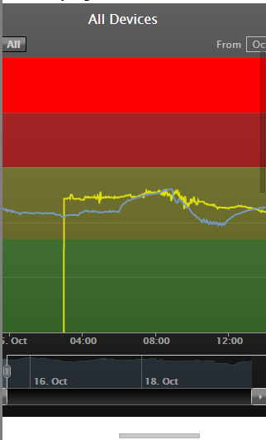
Implementation Before Google Charts

Slide 27
Implementation After Google Charts
Picture of mobile site implementing Google Charts.

Slide 28
Testing

Slide 29

Testing – What Was Used
Laravel built in testing framework
Additional PHP testing with PHPUnit
One hundred virtual sensors for load testing
Extreme temperature sensing
Notes:
P-unit logo
Add testing room, add testing devices, write testing code

Slide 30
Security

Slide 31
Security
Laravel Sessions
Input Sanitization
Passwords Hashed

Slide 32
Enrichments

Slide 33
Possible Enrichments
HTTP used for hosting XML on pi but HTTPS could be used instead if extra security is desired
Upgrade to newer web framework
Reporting for other sensors such as
Movement
Radiation
CO or CO2 Levels
Vibration sensing
Laser break beam sensing
New Raspberry PI B+ edition
Raw device data viewer
Notes:
(for earthquake prone states…california…)
14 July 2014 B+ release date

Slide 34
Maintenance

Slide 35
Maintenance
All code available on GitHub
Maintenance will be performed by WMU staff
Repository will be transferred to Dr. Kapenga
User manuals on setup process
Notes:
Our client is an open source advocate, prefers to have code available on an open source repository

Slide 36
Summary

Slide 37
Summary
Our device is more extensible
Our device cost breakdown as currently tested
$ 35.00 for the raspberry pi
$ 6.26 for the sensor
$ 8.70 for the wireless adaptor (optional)
$ 5.95 for the SD card
$ 55.91 total plus miscellaneous parts for in house sensor
$299.99 Temperature @lert wifi edition sensor
Our setup has a central server so that issues with one sensor does not affect ability to see temperature data
Notes:
Cheaper in bulk misc parts being cables and resistor power cable

Slide 38
Questions?

